Slide 1


ELECTRONICS AND COMMUNICATION ENGINEERING
Seed Sprayer Machine
TEAM MEMBERS :
SREVARSHINE.S SOBIYA.T SUJITHA.V
GUIDED BY Mrs.T.ABIRAMI, ASSISTANT PROFESSER, ECE DEPARTMENT.
(927621BEC208) (927621BEC205) (927621BEC222)

Slide 2
SYNOPSIS
Introduction
Existing System
Problem Statement
Objectives
Components
Advantages
Conclusion
Reference

Slide 3
INTRODUCTION
To meet the future food demands, the farmers have to implement the new techniques which will not affect the soil texture but will increase the overall crop production. Design and fabrication of seed sprayer machine technique seeds in a hopper get sprayed by means of fan or blower directly to land without human effort. By this process the seed is feed to land at the time of plough .The main benefit of using this method is to reduce the time of seed to the land and reduced human effort.

Slide 4
EXISTING SYSTEM:
Using Drone with Seed Dropper that describes a quadcopter drone properly incorporated with a seed sowing mechanism .
The drone can be flown over any specific location and drop seeds all over the region, thereby contributing to the growth of plants.

Slide 5
PROBLEM STATEMENT
Using rover with seed sprayer machine is a device which helps in the spraying of seeds in a desired position hence assisting the farmers in saving time and money. The basic objective of sowing operation is to put the seed and seed in rows at desired depth and seed to seed spacing, cover the seeds with soil. There is a greater need for multiple cropping on the farms and this in turn requires efficient and high capacity machine.

Slide 6
OBJECTIVES
To investigation of various types of seed sowing and spraying machine.
To development of solar powered seed sowing and seed spraying machine.
To testing of development of solar powered seed sowing and seed spraying machine in actual agricultural farm.

Slide 7
COMPONENTS
Hopper
DC Motors
DC Fan
Servo Motors
Controller Circuitry
Wireless Remote
Battery

Slide 8
HOPPER
In this technique seeds in a hopper get sprayed by means of fan or blower directly to land without human effort. By this process the seed is feed to land at the time of plough . The main benefit of using this method is to reduce the time of seed to the land and reduced human effort.

Slide 9
DC MOTOR AND DC FAN
The power to DC motor is given by battery and DC motor is connected to the rear wheel of the machine using transmission system.
The battery powers the DC motor and fan/blower. Seeds are stored in the hopper and blown out by the fan/blower in a uniform pattern over a field.

Slide 10
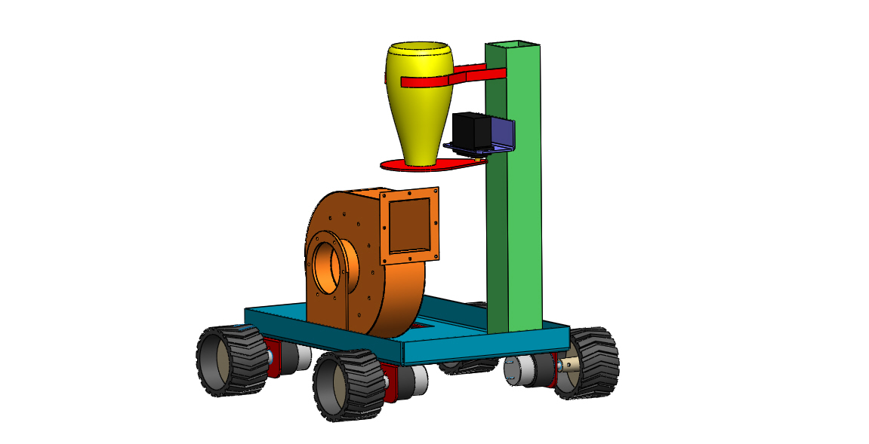
DIAGRAM

Slide 11
ADVANTAGES
By using this innovative project of seed sowing equipment we can save more time required for sowing process and also it reduces lot of laborer cost.
It will be avoid the fuel usage.
It is very helpful for small scale farmers.

Slide 12
CONCLUSION
A seed sprayer machine is designed for small farmers to improve their productivity. In this machine a common seed storage place is introduced to reduce the cost of the machine Thus battery operated automatic seed sowing machine will help the farmers of those remote areas of country where fuel is not available easily. And also they can perform their regular cultivation activity as well as saves fuel up to larger extent.Thus aiming to save the revenue of government & also most demanded fossil fuel.

Slide 13
REFERENCE
Mahesh. R. Pundkarand A. K. Mahalle, “A Seed-Sowing Machine: A Review” International Journal of Engineering and Social Science, Volume3, Issue3, Pp-68-74.
D. Ramesh and H. P. Girishkumar, “Agriculture Seed Sowing Equipments: AReview”, International Journal of Science, Engineering and Technology Research, 2014, Volume 3, Issue 7, Pp-1987-1992.

Slide 14


